Slide 1
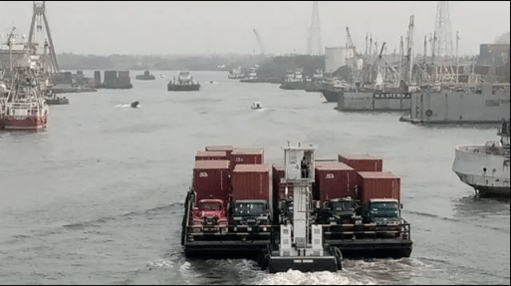
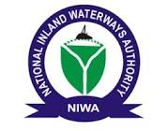
The Challenges of Keeping the Internal Waterways Navigable
ALL YEAR ROUND TO SERVE AS A CONSISTENT MODE OF TRANSPORTATION IN THE FACE OF WORSENING CLIMATE CHANGE
CHIEF (DR.) George N. Moghalu
Managing Director/ CEO NIWA
NATIONAL INLAND WATERWAYS AUTHORITY
(NIWA)
PRESENTATION ON
16th FEBUARY, 2022

Slide 2
HIGHLIGHTS
INTRODUCTION
Nigerian Inland Waterways: Federal Navigable waterways (Internal waters of Nigeria)
Navigability of Nigerian Inland Waterways
Challenges to keeping Nigerian waterways navigable all-year round.
Effects/ Impacts of worsening climate change to navigation on the Inland Waterways.
Efforts by the Authority to Mitigate the challenges of Navigability on the Nigeria Inland Waterways.
CONCLUSION

Slide 3
INTRODUCTION
THE NIGERIAN INLAND WATERWAYS
The Nigerian Inland Waterways also known as the Federal navigable waterways are specified in the second schedule section 5 of the NIWA Act CAP N47,LFN 2004. The major ones are the Rivers Niger and Benue which constitute the Major channels for Inland navigation; which also include intra-coastal routes and numerous creeks in the Niger Delta Area, etc.

Slide 4
INTRODUCTION
INLAND WATERWAYS TRANSPORTATION
Generally, inland waterway transport is characterized by a high degree of reliability and safety compared to other transport modes. Inland Waterways Transportation is expected to be more sensitive to climate change aspects than other transport modes, e.g. in terms of water level fluctuations and resulting effects on costs and reliability.
CLIMATE CHANGE?
Climate change refers to long-term shifts in temperatures and weather patterns. These shifts may be natural, such as through variations in the solar cycle or through the activities of humans, such as global warming.

Slide 5
INTRODUCTION
NAVIGABILITY OF NIGERIAN INLAND WATERWAYS
A waterways is navigable if such body of water (River, Lagoons, Creeks, Canal, Lake) is very deep, wide and calm enough for specific vessels to pass safely with few obstructions and encumbrances (Wikipedia).
Nigeria has large expanse of waterways system acclaimed to be over 10,000km but unfortunately a little over 3,000km of this waterways are navigable all year round. 28 states of the 36 states can be accessed through the inland waterways. Nigeria can also link five of its neighboring Countries; Benin Republic (Porto Novo), Equatorial Guinea, Cameroon, Chad and Niger Republic by water.

Slide 6
CHALLENGES TO KEEPING NIGERIAN WATERWAYS ALL-YEAR ROUND NAVIGABLE
Impediments to Navigation is not just only blockage of channels by wrecks, dirts, hyacinths, high saltation of riverbeds but the issue of insecurity is also a major challenge.
However, there is heavy infrastructural intervention requirement to make these waterways navigable – Dredging to remove silt and other impediments; construction of River ports and Jetties; installation and maintenance of navigational aids such as Buoys, Lights and Marks, River Training Works, etc; are compulsory requirements for safe/secure navigability.

Slide 7
EFFECTS/ IMPACTS OF WORSENING CLIMATE CHANGE TO NAVIGATION ON THE INLAND WATERWAYS
Inland waterways Transportation (IWT) plays a very significant role in the movement of cargoes all over the world. It is considered to be a very efficient, and infact, the most cost effective mode of transportation when movement of bulk haulage over a reasonable distance is considered.
However, extreme weather conditions can significantly affect this mode and these include flooding, droughts, formation of iceberg. Extreme weather conditions due to climate changes can considerably reduce water levels and navigable drafts becomes critically low and therefore impose huge limitations to navigation.

Slide 8
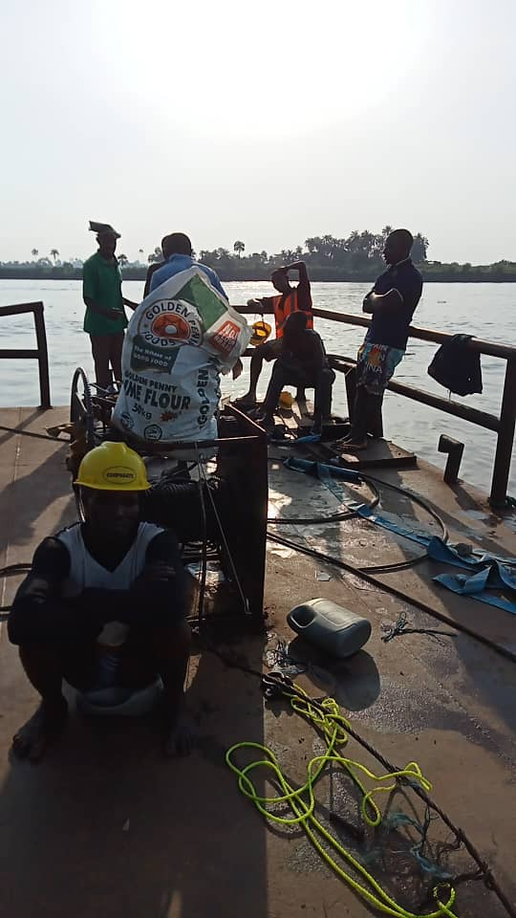
EFFECTS/ IMPACTS OF WORSENING CLIMATE CHANGE TO NAVIGATION ON THE INLAND WATERWAYS
WRECK REMOVAL AT BAYELSA

Slide 9
EFFECTS OF CLIMATE CHANGE ON THE INLAND WATERWAYS
Rising Maximum Temperatures
Rising Minimum Temperatures
Rising Sea Levels
High Ocean Temperatures
Heavy Rainfall
Shrinking Glaciers
Thawing Permafrost

Slide 10
IMPACTS OF CLIMATE CHANGE ON THE INLAND WATERWAYS
Droughts and Desertification
Flooding
Iceberg
Snow
Infestation by Water Hyacinth/ Weed

Slide 11
IMPACTS OF CLIMATE CHANGE ON THE INLAND WATERWAYS
DROUGHTS AND DESERTIFICATION
Droughts can significantly impact inland waterways navigation by reducing water levels at which Vessels are constrained to move with smaller loads or freights.
Apart from low loads, there is also delayed time for navigation as at low water levels, vessels operate below capacity and low speed.

Slide 12
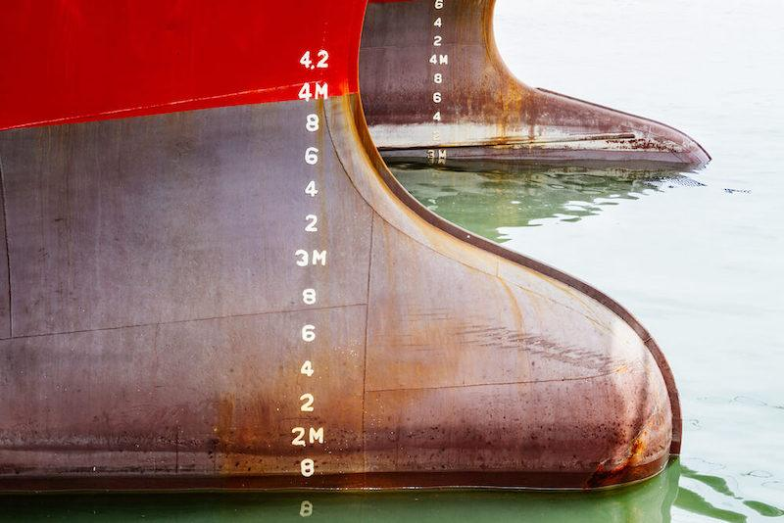
IMPACTS OF CLIMATE CHANGE ON THE INLAND WATERWAYS
Image showing a Ship at Low Water Draft

Slide 13
IMPACTS OF CLIMATE CHANGE ON THE INLAND WATERWAYS
FLOODING
Extreme Flooding due to high climatic change erode the river banks and increases the siltation level of our Riverbed. The bed of River Niger is Alluvial in Nature and therefore very sensitive and collapse considerably with little impact like water waves or flooding. This causes excessive siltation on River channels and reduces the water levels.
ICEBERG
Navigation in Ice waters can be a real task for vessels, a detour from navigable routes will lead to additional fuel wastages and this might also lead to damage of vessels.

Slide 14
IMPACTS OF CLIMATE CHANGE ON THE INLAND WATERWAYS
SNOW
The impacts of snow to navigation is not much pronounced but in some occasions it can affect Global Positioning System (GPS) readings and therefore reduce visibility to navigation.

Slide 15
IMPACTS OF CLIMATE CHANGE ON THE INLAND WATERWAYS
INFESTATION BY WATER HYACINTH/ WEED
Water hyacinth is a type of invasive floating plant found in water bodies across the world. These invasive species block the sunlight reaching and oxygen level in water systems, which results in damaging water quality. Water Hyacinth makes it hard for vessels to navigate along the waterways, the weeds can get stuck in the engines which could cause engine faults. In certain weather conditions, the amount of water hyacinths that can be found in the waterways can be a lot and due to this, transportation of both cargoes and passengers become really slow and risky.
To eradicate or control water hyacinth a Manual or mechanical method is applied. The mechanical method is employed by directly harvesting, cutting, and removing the plant using machines or manual removal by hands and hand tools.

Slide 16
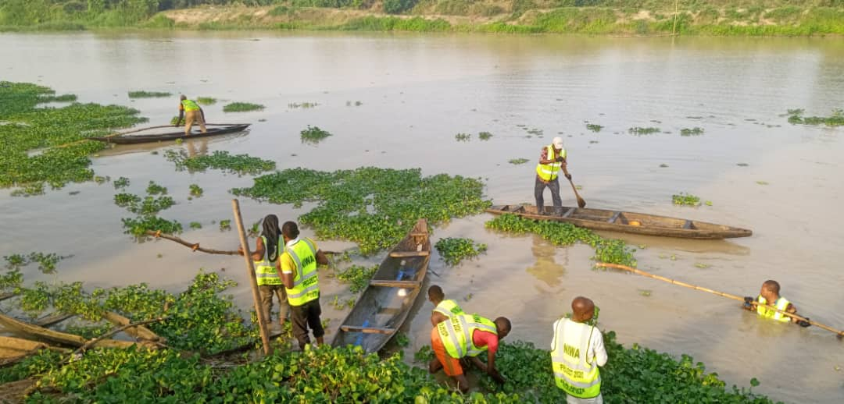
IMPACTS OF CLIMATE CHANGE ON THE INLAND WATERWAYS
MANUAL WATER HYACINTH CLEARING AT OGUN STATE

Slide 17
EFFORTS BY THE AUTHORITY TO MITIGATE THE CHALLENGES OF NAVIGABILITY ON THE NIGERIA INLAND WATERWAYS
The Authority is intervening in specific areas to mitigate these challenges by undertaking the following projects:
Building and rehabilitation of more waterways support structures.
Channel management and enhancement of some navigation routes through laying of navigation buoys.
Constant clearing of water hyacinth and other aquatic weeds.

Slide 18
EFFORTS BY THE AUTHORITY TO MITIGATE THE CHALLENGES OF NAVIGABILITY ON THE NIGERIA INLAND WATERWAYS
Maintenance dredging of some channels to remove salt and increase draft.
River training works and construction of shore protection walls .
Engagement and strategic partnership with both private and public sector stakeholders for investment on the sector.
Trainings, safety enlightenment and campaigns for stakeholders.
Canalization of navigable routes.
Installation of water level gauges and collation of such data.

Slide 19
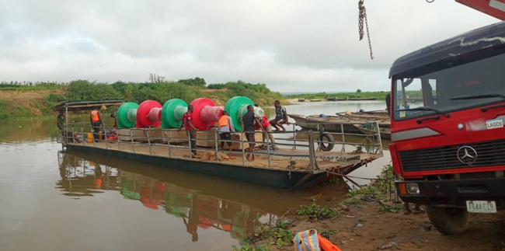
EFFORTS BY THE AUTHORITY TO MITIGATE THE CHALLENGES OF NAVIGABILITY ON THE NIGERIA INLAND WATERWAYS
ONGOING LAYING OF BUOYS ON THE INLAND WATERWAYS BY NIWA

Slide 20
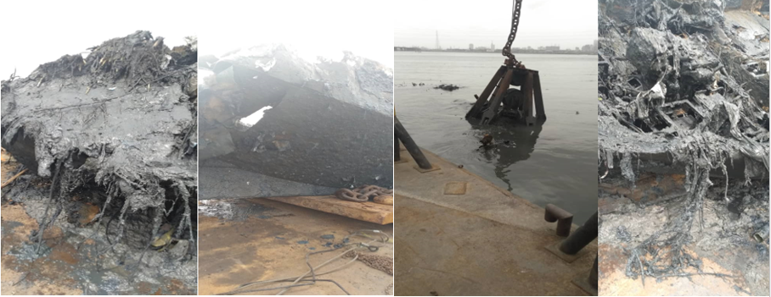
EFFORTS BY THE AUTHORITY TO MITIGATE THE CHALLENGES OF NAVIGABILITY ON THE NIGERIA INLAND WATERWAYS
WRECK REMOVAL PROJECTS IN SOME NAVIGABLE CHANNELS IN LAGOS IN 2019

Slide 21
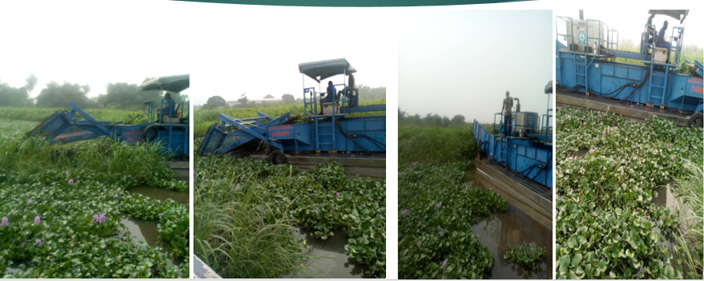
EFFORTS BY THE AUTHORITY TO MITIGATE THE CHALLENGES OF NAVIGABILITY ON THE NIGERIA INLAND WATERWAYS
MECHANICAL CLEARING OF WATER HYACINTH

Slide 22
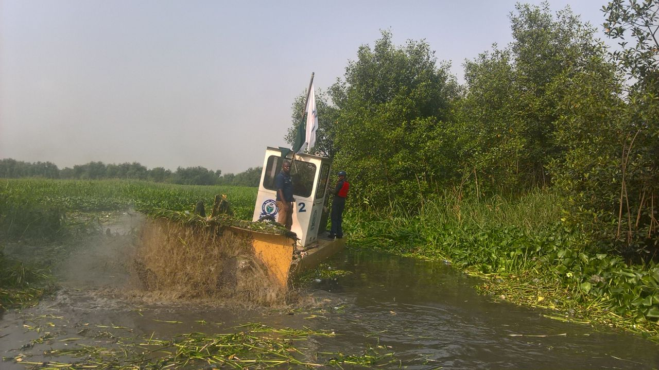
EFFORTS BY THE AUTHORITY TO MITIGATE THE CHALLENGES OF NAVIGABILITY ON THE NIGERIA INLAND WATERWAYS
PICTURES OF NIWA SWAMPDEVIL DEPLOYED TO CLEAR WATER HYACINTH

Slide 23
CONCLUSION
Like any other mode of transportation, Inland waterways navigation is not exempted or devoid from the vagaries of worsening global climatic change.
The irregular fluctuation of water level, the unpredictable massive infestation of water hyacinth on the waterways even in February is a clear testimony of changing climatic conditions. The impact of high droughts, flooding, high temperature rise have serious consequences to effective and smooth navigation on the waterways and therefore need proactive measures to mitigate these challenges as they occur.

Slide 24
CONCLUSION
The Authority as an Agency saddled with the responsibility of ensuring safe and secured navigation on the Nigerian Inland waterways is not taking this for granted and therefore working assiduously to ensure that basic infrastructures and necessary measures are put in place to make our waterways navigable in spite of other daunting challenges.

Slide 25
THANK YOU
FOR
LISTENING

